Slide 1
Narrative Non- Fiction
Laurie Travis, Library Media Specialist
Jones Paideia Magnet Elementary School
Notes:
10 seconds

Slide 2
"If history were taught in the form of stories, it would never be forgotten" ~ Rudyard Kipling
Notes:
10 seconds

Slide 3
What is narrative non-fiction?
Narrative nonfiction, often also referred to as creative nonfiction, is a literary term for a text that presents a true story written in a style more closely associated with fiction.
Notes:
30 seconds

Slide 4
According to narrative nonfiction author Elizabeth Partridge:
It’s called narrative nonfiction, sometimes called creative nonfiction, or literary nonfiction. I prefer narrative nonfiction. It boils down to this: making sure we are telling a story. The author of narrative nonfiction uses all of the best techniques of fiction writing: plot, character development, voice, and theme.
Notes:
30 sec

Slide 5
More from Elizabeth Partridge
We begin with an idea that smacks us in the head.
Notes:
45 sec Nonfiction often gets accused of just being about plot. But here’s that famous quote by Nabokov (himself paraphrasing E. M. Forster) that shows what we are striving for: “The term ‘narrative’ is often confused with the term ‘plot,’ but they’re not the same thing. If I tell you that the king died, and then the queen died, that’s not narrative; that’s plot. But, if I tell you that the king died, and then the queen died of a broken heart, that’s narrative.” So narrative nonfiction takes people, places, and events, builds bridges between them, gives them meaning and emotional content. Without making anything up.

Slide 6
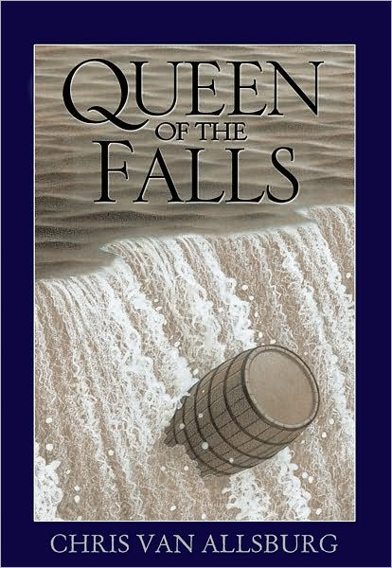
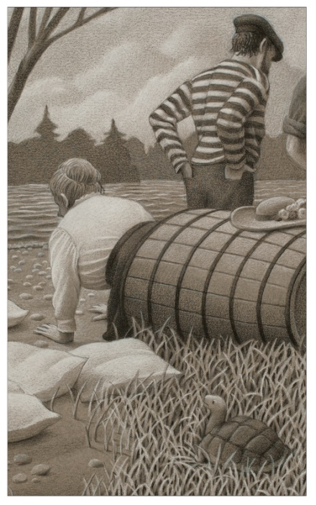
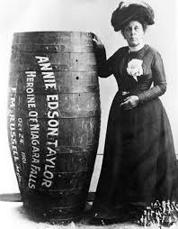
Chris Van Allsburg had an idea that smacked him in the head.
He wrote his first non-fiction book about Annie Taylor, the first woman to go over Niagara Falls in a barrel and survive!

Slide 7
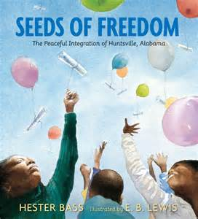
Hester Bass had an idea that smacked her in the head.
A southern city that had a peaceful experience with integration! The illustrator E.B. Lewis added his lush watercolors to the project.

Slide 8
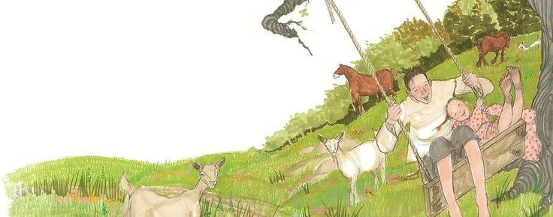
Narrative nonfiction for children
In narrative non-fiction for children, the illustrations are equally important as the text.
Notes:
45 sec Visual Emphasis
One radical change in recent children's nonfiction has been the emphasis on visually attractive design layouts (Giblin, 2000). Carter (2000) said that
Forty years ago, children read nonfiction books with small type and limited illustrations… Today, they encounter books with carefully designed illustrations that partner with the text to contribute to their thinking… Illustrations introduce core concepts necessary for understanding a topic and serve as integral portions of each book. (p. 707)
Every book I reviewed contained illustrations or other visual features on almost every page. Although all of the books are visually appealing, many also use the visual elements to convey information. Illustrations appear on the covers, endpapers, copyright pages, and title pages, as well as in tables of contents and end matter such as notes from the authors. Many nonfiction books now contain sidebars, use different typefaces to emphasize text, have additional information in the margins, and include captioned photos.

Slide 9
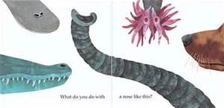
From What do you do with a tail like this?
Notes:
10 sec

Slide 10
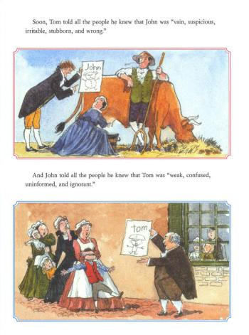
From The Worst of Friends
Notes:
10 sec

Slide 11
Criteria for selecting nonfiction picture books
Is the book visually appealing?
Is the book accurate and authoritative?
Is the writing style engaging?
Notes:
1:00
Criteria for selecting nonfiction picture books
Is the book visually appealing?
Are the front and back covers appealing?
Are the endpapers appealing? Do they contribute to the topic, theme, or tone of the book?
Do the title page, dedication page, table of contents, and other pages contain illustrations?
Is the typeface easy to read? Does the book use typefaces or text layout to highlight information? Does the choice of typeface contribute to the topic, theme, or tone of the book?
Are the illustrations appealing?
Is the text broken up with illustrations, sidebars, headings, white space, and other features?
Are the illustrations and book design colorful? Do the colors contribute to the topic, theme, or tone of the book?
Are borders used?
Is the book accurate and authoritative?
Are consultants listed?
Is information about the research process provided in introductory or endnotes, source notes, or bibliographies?
Are there suggestions for further reading?
Are supplemental materials such as glossaries and tables of important dates included?
Do illustrations accurately depict the text?
Are animals depicted accurately without anthropomorphism?
Is the book a blend of fact and fiction? If so, is it clear which parts of the book are fact and which are fiction?
Is the writing style engaging?
Does the author draw the reader in with an engaging lead?
Are ideas logically ordered?
Is the background knowledge of the reader considered? Are new ideas connected to what children already know?
Is the language appropriate for the audience?
Does the author write without condescension?
Is the author able to explain difficult concepts clearly and simply?
Does the author use an appropriate tone?
Are there interactive elements that help involve the reader?
Are new terms clearly explained, highlighted, and defined in a glossary?

Slide 12
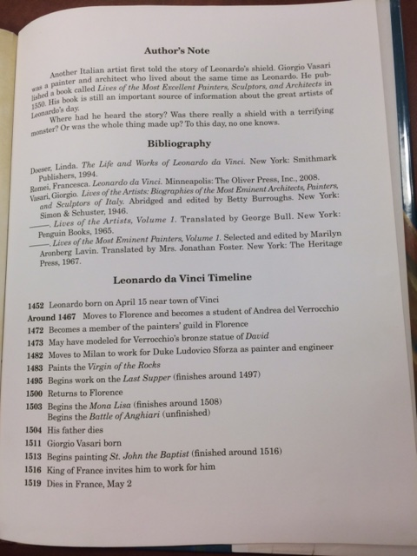
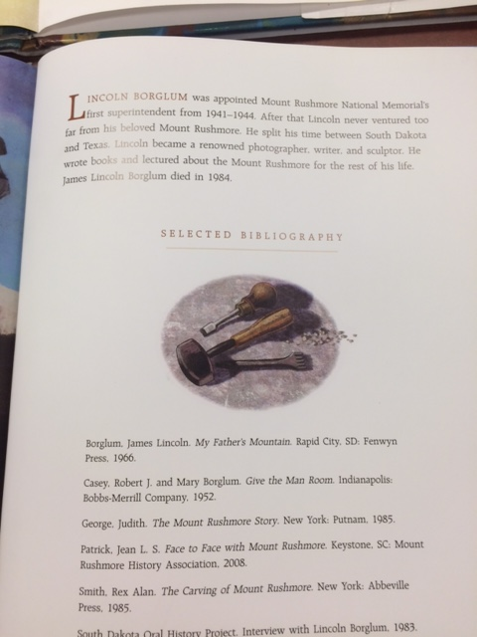
Two of the shorter examples of notes and bibliographies
Notes:
20 sec

Slide 13
Bibliography
Gill, S. R. (2016) . What teachers need to know about the “new" nonfiction. Retrieved from http://www.readingrockets.org/article/what-teachers-need-know-about-new-nonfiction
Partridge, E. (2013). Narrative Nonfiction: Kicking Ass at Last. The Horn Book Magazine. Retrieved from http://www.hbook.com/2013/04/choosing-books/horn-book-magazine/narrative-nonfiction-kicking-ass-at-last/#

